Slide 1
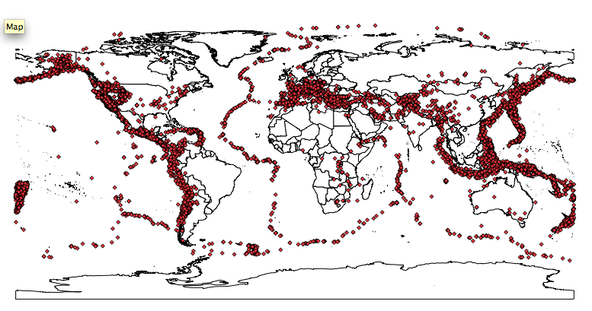
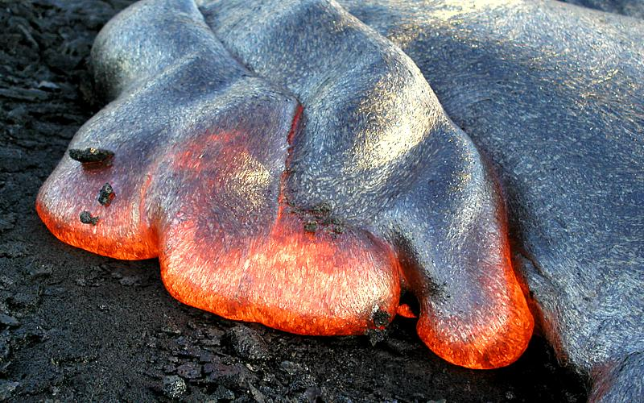
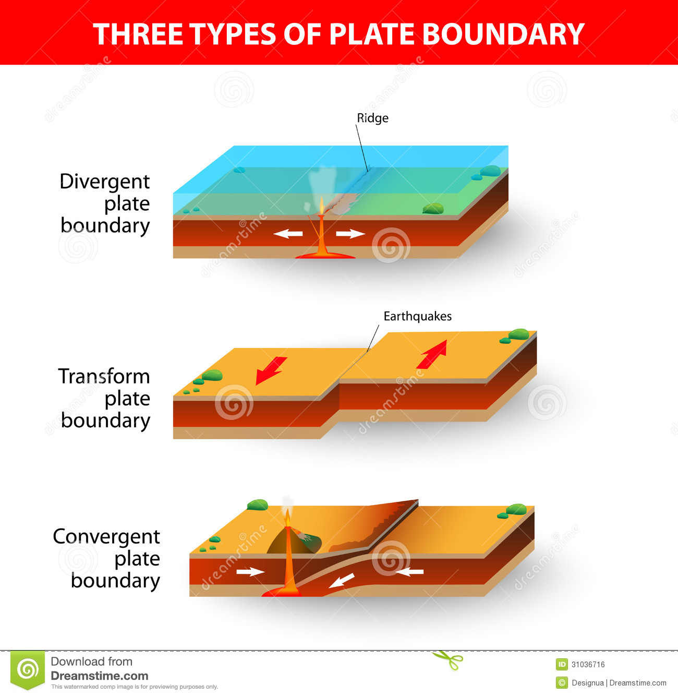
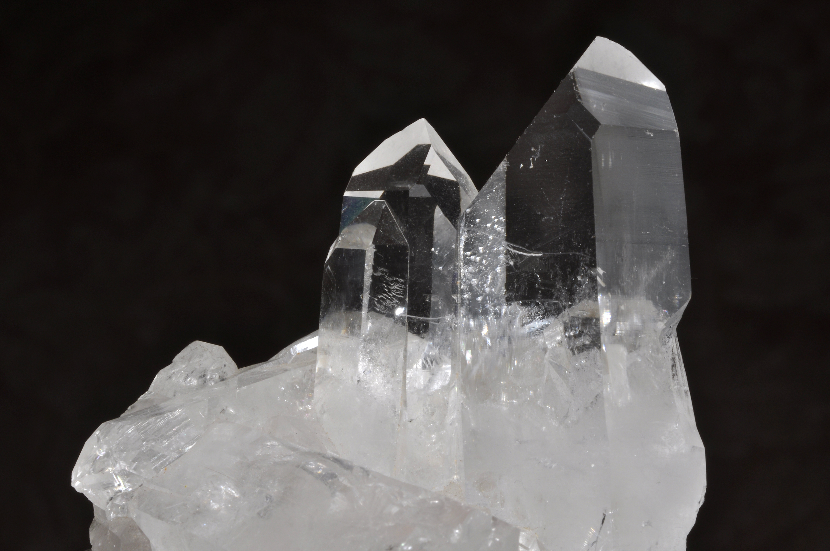
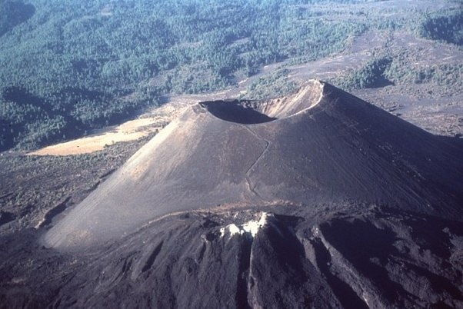
Bellwork:
Earthquakes, Volcanoes, and Rocks

Slide 2
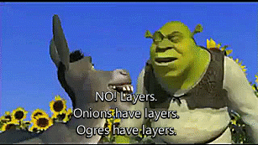
The Earth is like an Ogre… It has LAYERS
Bellwork
What are some of the earth layers you know of? What are they made of?

Slide 3
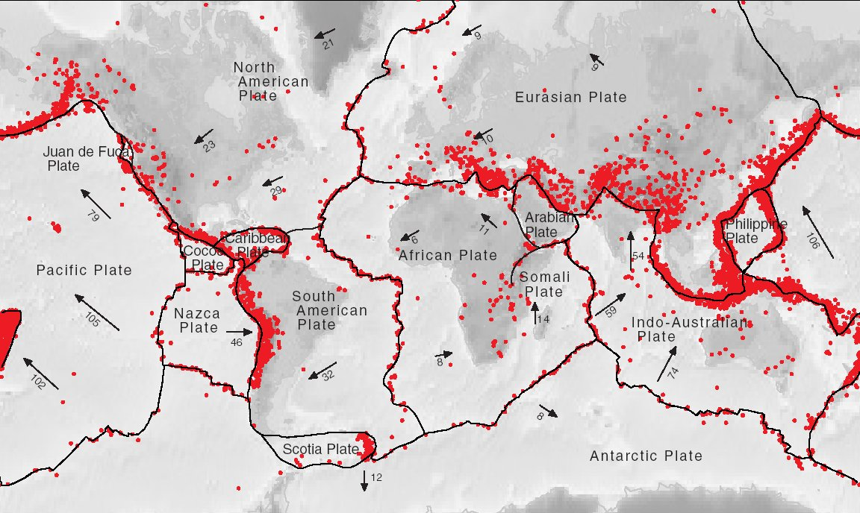
Bellwork
Each RED dot represents a recorded earthquake.
Describe where most earthquakes occur? Why do you think this is the case?

Slide 4
Bellwork
What are the 3 different types of plate boundaries?

Slide 5
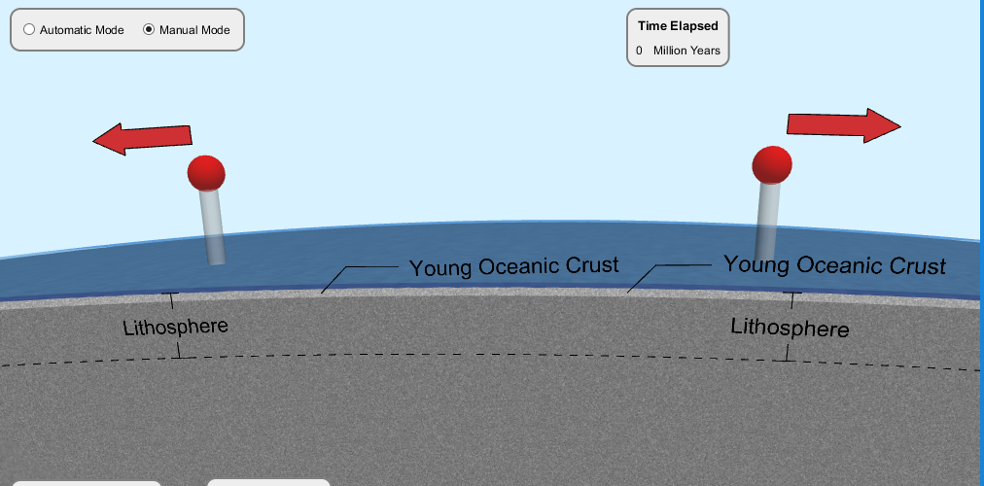
Bellwork
Make a prediction about what will happen if the plates move in the direction of the red arrows. Include:
boundary
type
Notes:
You can run the simulation after by clicking on the picture! I put a link there.

Slide 6
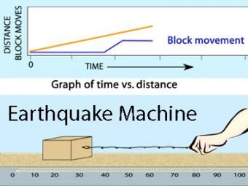
Bellwork
In your own words (think of our earthquake demo) walk me through the process of an earthquake happening :0

Slide 7
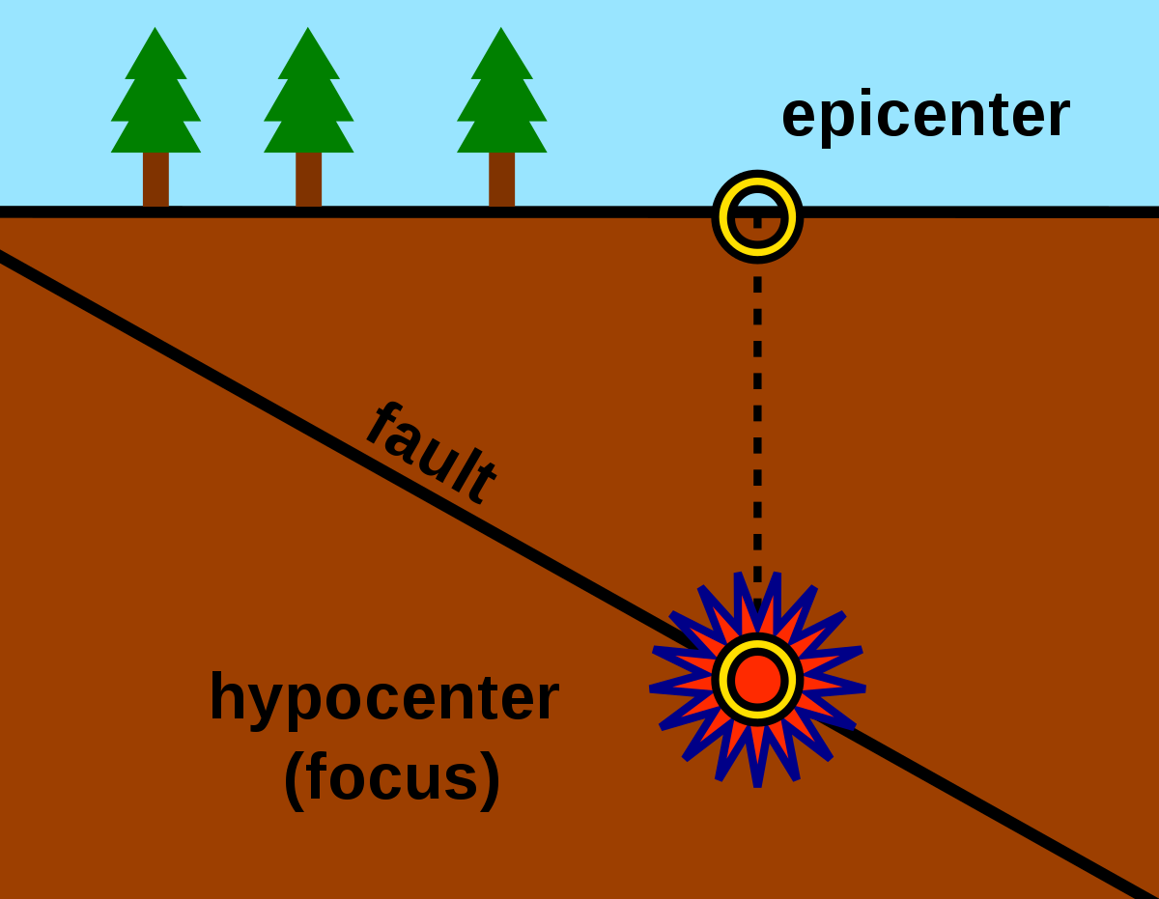
Bellwork
Draw the image in your notebook!

Slide 8
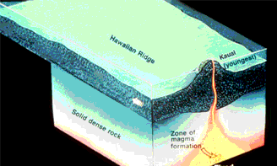
Bellwork
Based on the .gif below explain how the Hawiian Islands were formed!

Slide 9
Bellwork
Yesterday we learned about the Cinder-Cone type of volcano! How does it form?
Can you think of another way a volcano can form!?

Slide 10
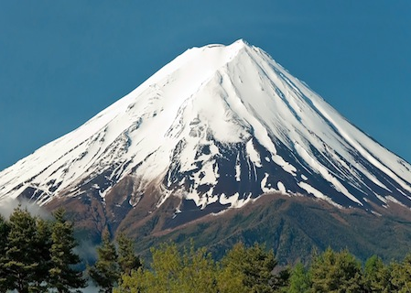
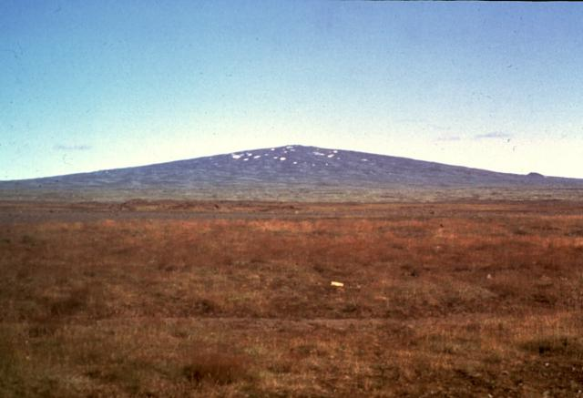
Bellwork
Do you Vol-ca-know the right ones?
Below are 3 pictures of volcanoes assign a type to each one and 1 reason why you chose it.
B
C
A

Slide 11
Bellwork
List as many ways as you can think of to change a rock into something else!

Slide 12
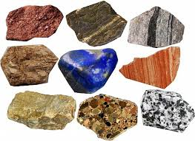

Bellwork- what even IS a rock?
Rocks - are any naturally occurring solid mass or combination of minerals. It is categorized by the minerals included, its chemical composition and the way in which they are formed.

Slide 13
Bellwork
What are the 3 different types of rocks?
How does each one form?
You may use your Rock Cycle Image.

Slide 14
Bellwork
At each table there is a rock. Using you best descriptive language describe this rock to the class with a high degree of accuracy.
Hardness...
Color...
Streak...
Luster. ...
Cleavage...
Smell...
Notes:
(this one you need to provide a rock)

Slide 15
Bellwork
What are 3 physical properties of this mineral?

Slide 16
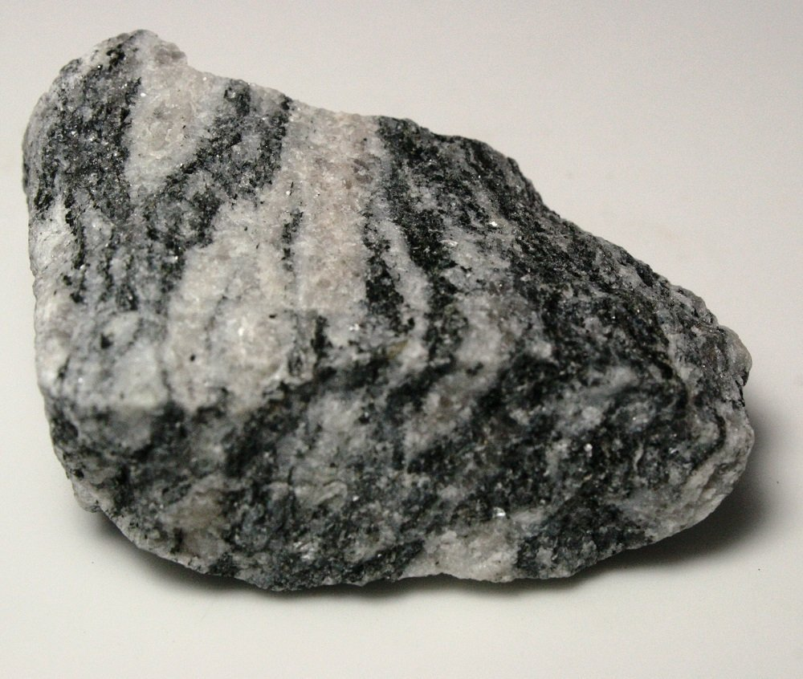
Bellwork
What type of rock is this?
Cite specific evidence from the image.

Slide 17
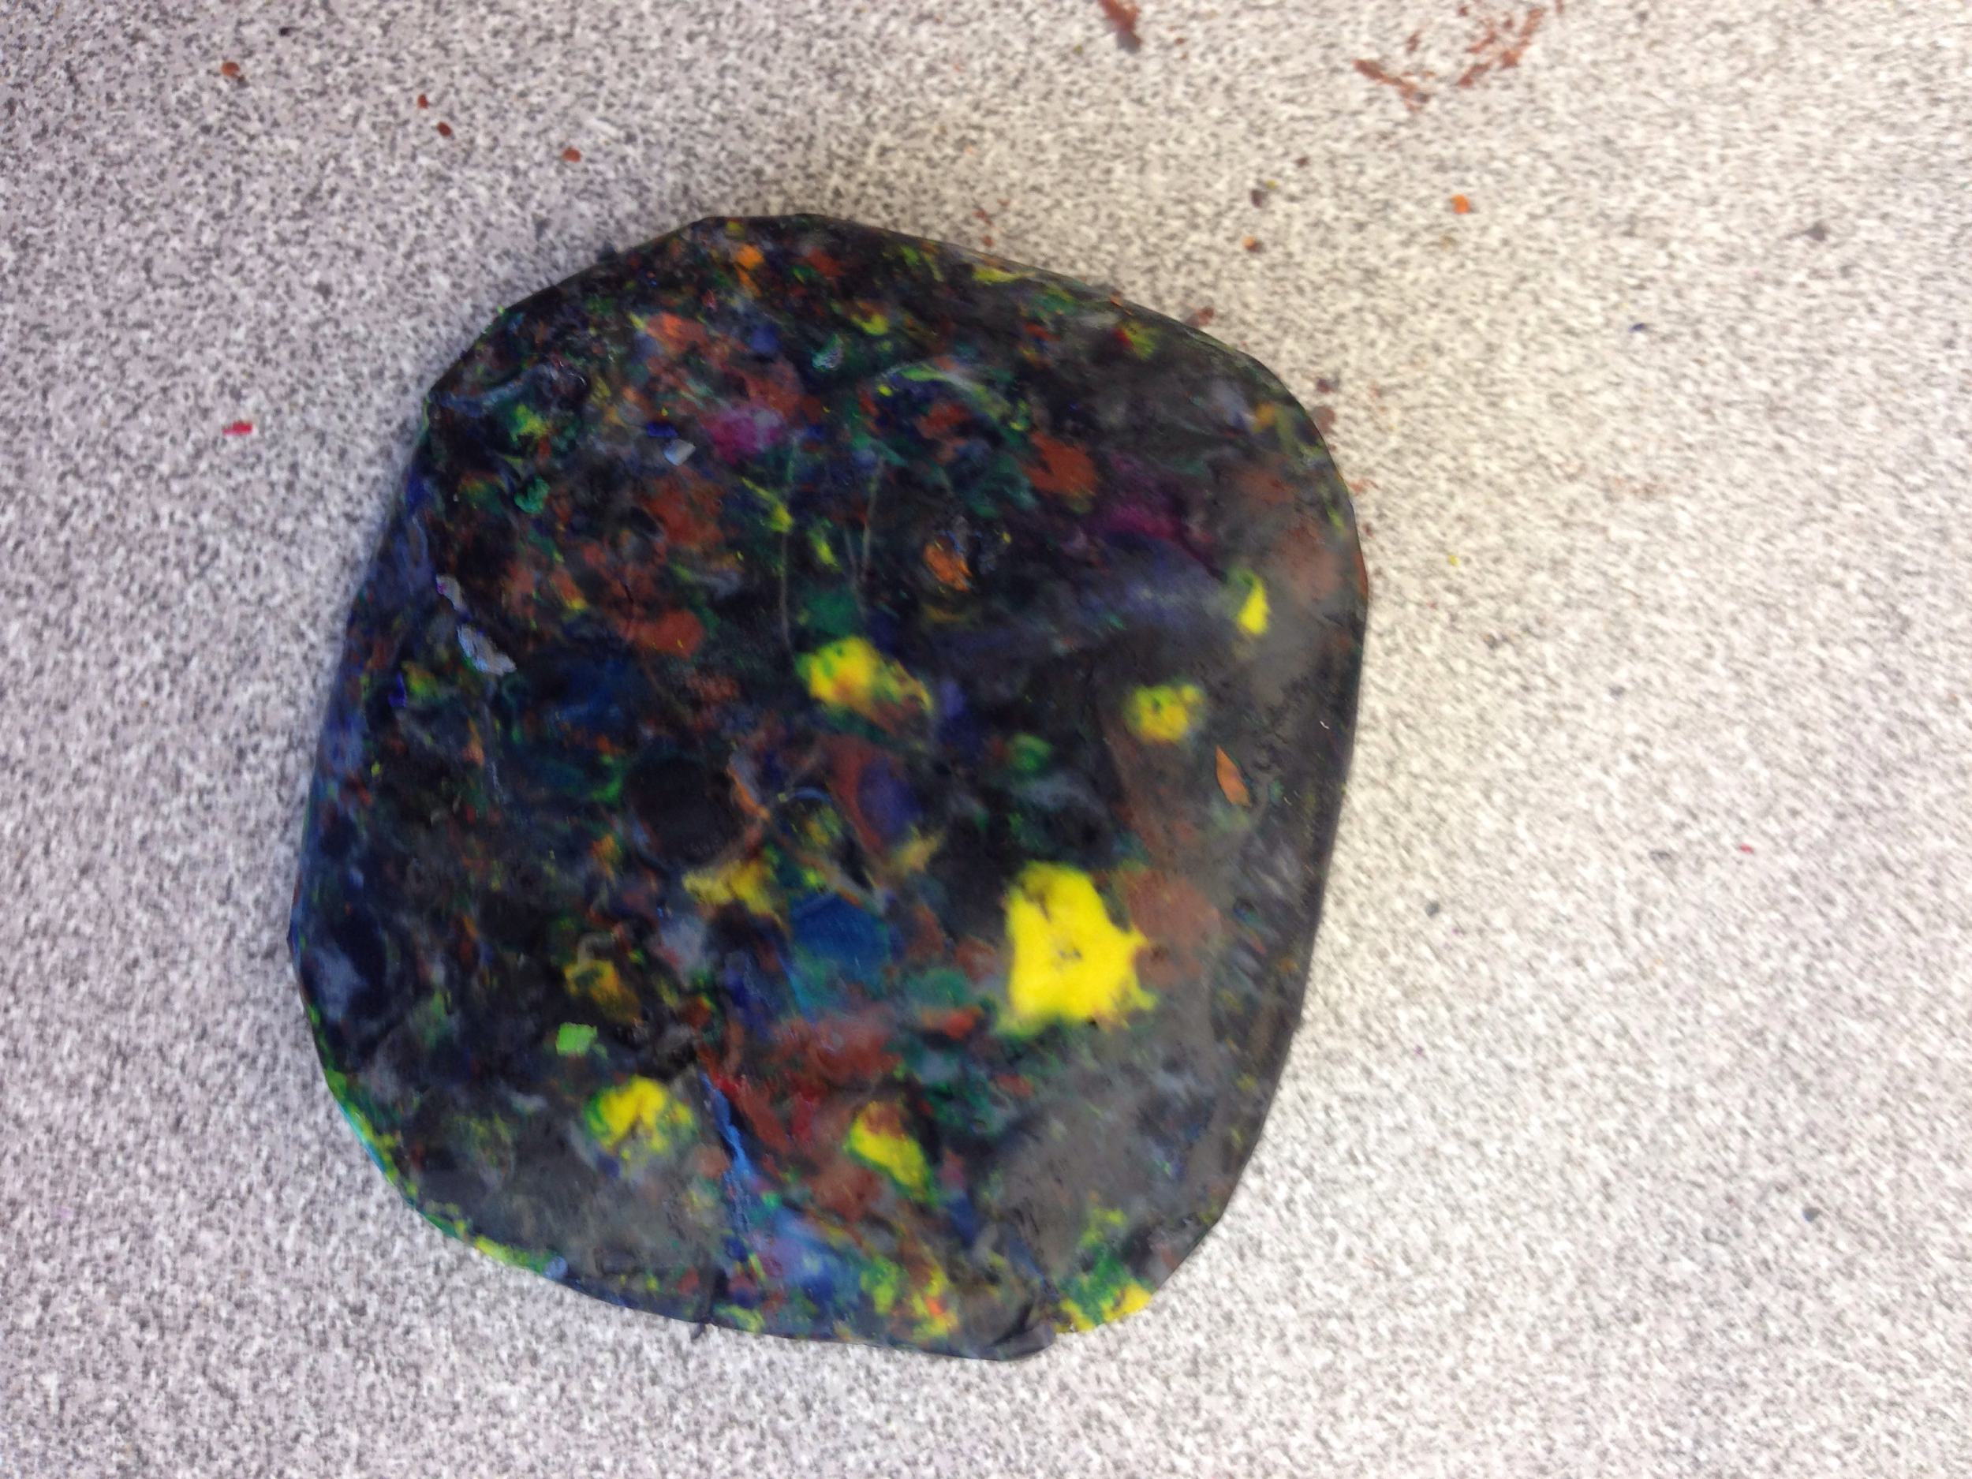
Bellwork
Look at this cool crayon rock! What type of rock would this be and how did it form? Give two pieces of evidence!

